Slide 2
US Craft Beers and Breweries Presentation
By Balasubramaniam and Muchigi

Slide 3
Discussion Points
Data Description
Number of Breweries in each State
Address Missing Values
Explain the Median alcohol content and international bitterness
Outline the State with the Maximum alcohol content and international bitterness
Which state has the maximum alcoholic (ABV) And bitter (IBU) beer?
Comment on the summary statistics and distribution of the ABV variable
Relationship between the bitterness of the beer and its alcoholic content
Address the difference with respect to IBU and ABV between IPAs and Ale

Slide 4
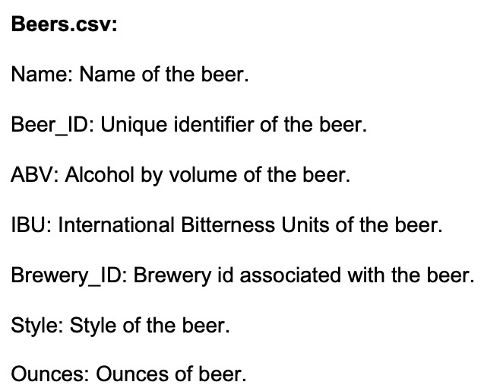
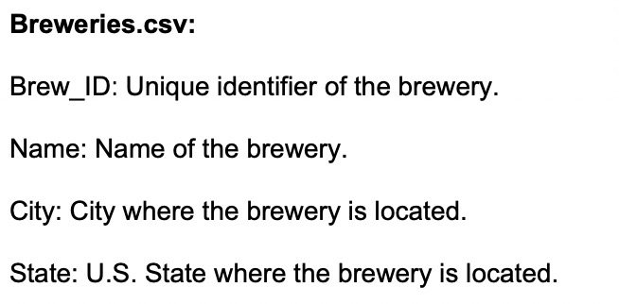
Data Description

Slide 5
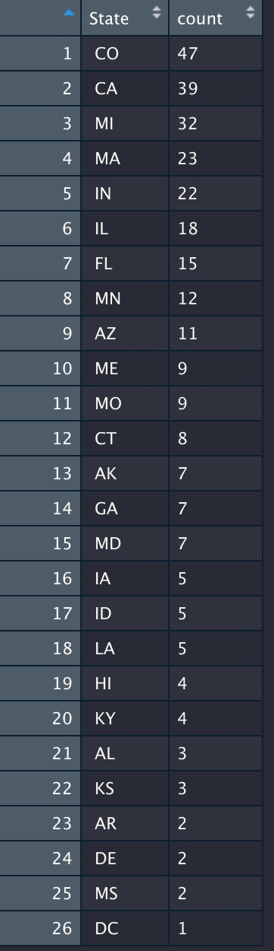
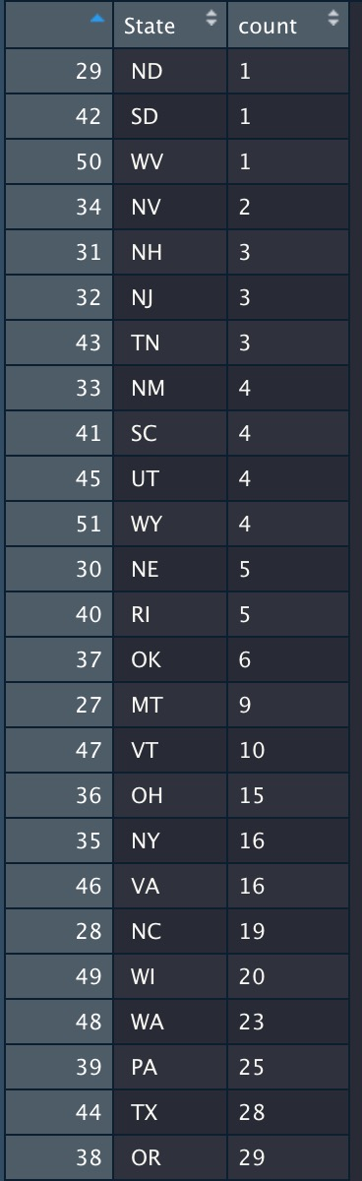
How many breweries are present in each state?

Slide 6
How many breweries are present in each state?
Inference: Top 3 Highest No Breweries in USA
 | No of Breweries | State
1 | 47 | CO- Colorado
2 | 39 | CA- California
3 | 32 | MI- Michigan

Slide 7
How many breweries are present in each state?

Slide 8
Address the missing values in each column.
ABV | IBU | Style
62 | 1005 | 5

Slide 9
Compute the median alcohol content and international bitterness unit for each state.

Slide 10
Compute the median alcohol content and international bitterness unit for each state. Plot a bar chart to compare ABV per State

Slide 11
Which state has the maximum alcoholic (ABV) And bitter (IBU) beer?
ABV | IBU | State
ABV |  | MA-Massachusetts
 | IBU | NJ- New Jersey

Slide 12
Comment on the summary statistics and distribution of the ABV variable.
ABV is normally in the range of 0.001 to 0.128.
But most of the beers in the country have a ABV of 0.059
Based on the histogram and qqplot we can see that the distribution is normally distributed

Slide 13
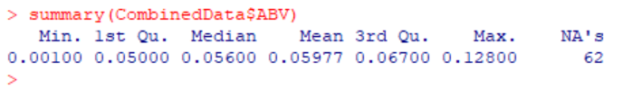
Comment on the summary statistics and distribution of the ABV variable
Below is the summary statistic result

Slide 14
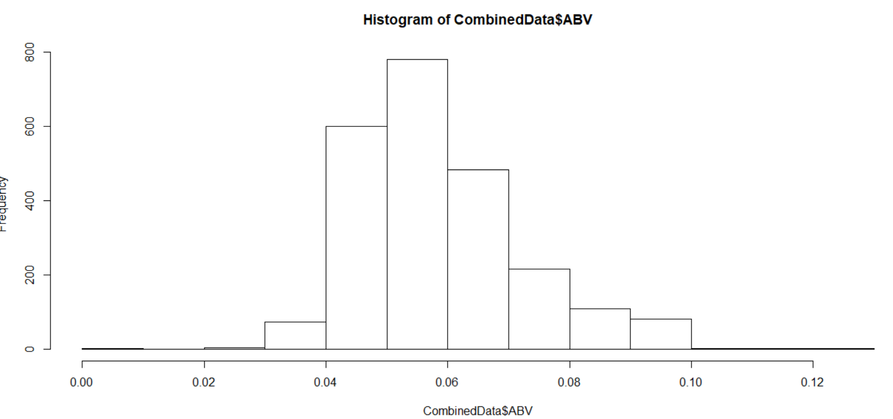
Comment on the summary statistics and distribution of the ABV variable.

Slide 15
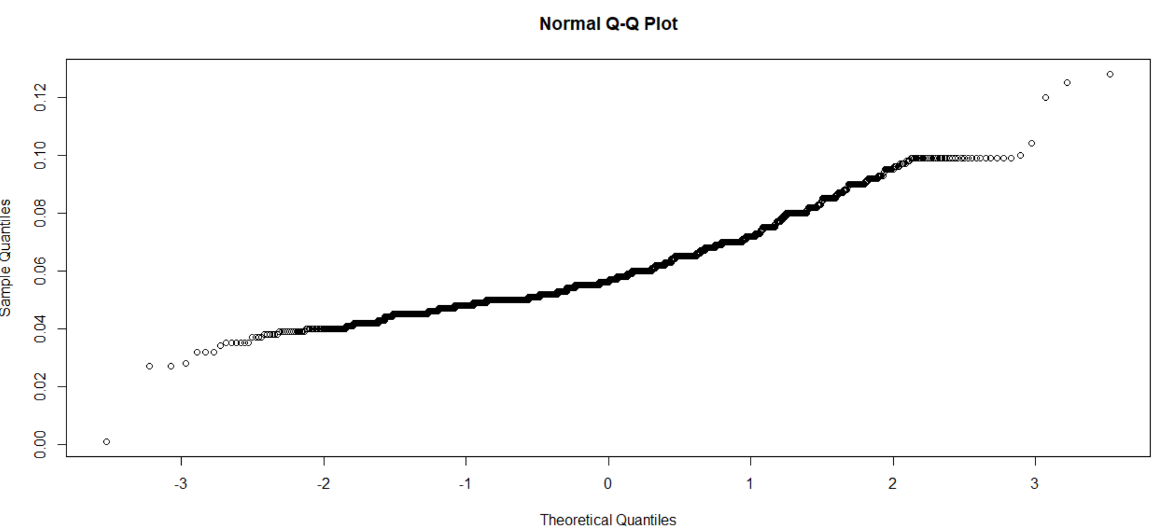
Comment on the summary statistics and distribution of the ABV variable

Slide 16
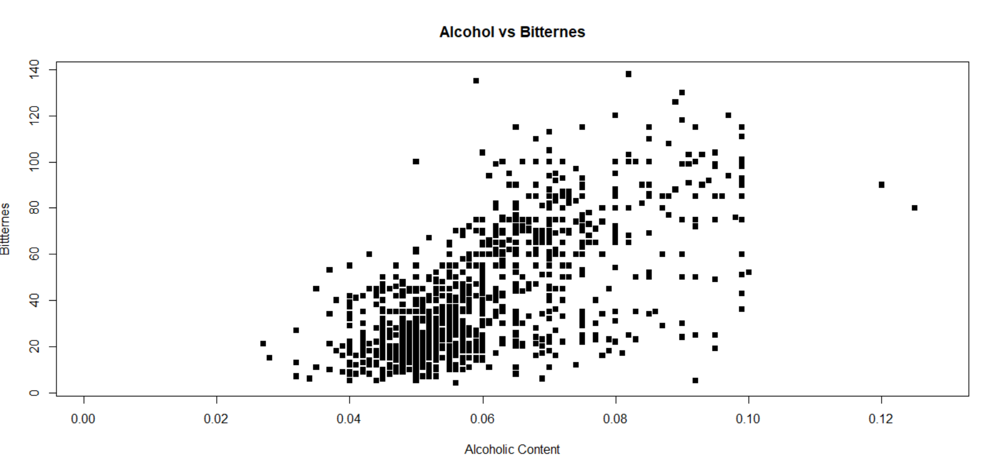
Is there an apparent relationship between the bitterness of the beer and its alcoholic content? After Removing NA Value/Draw a scatter plot.

Slide 17
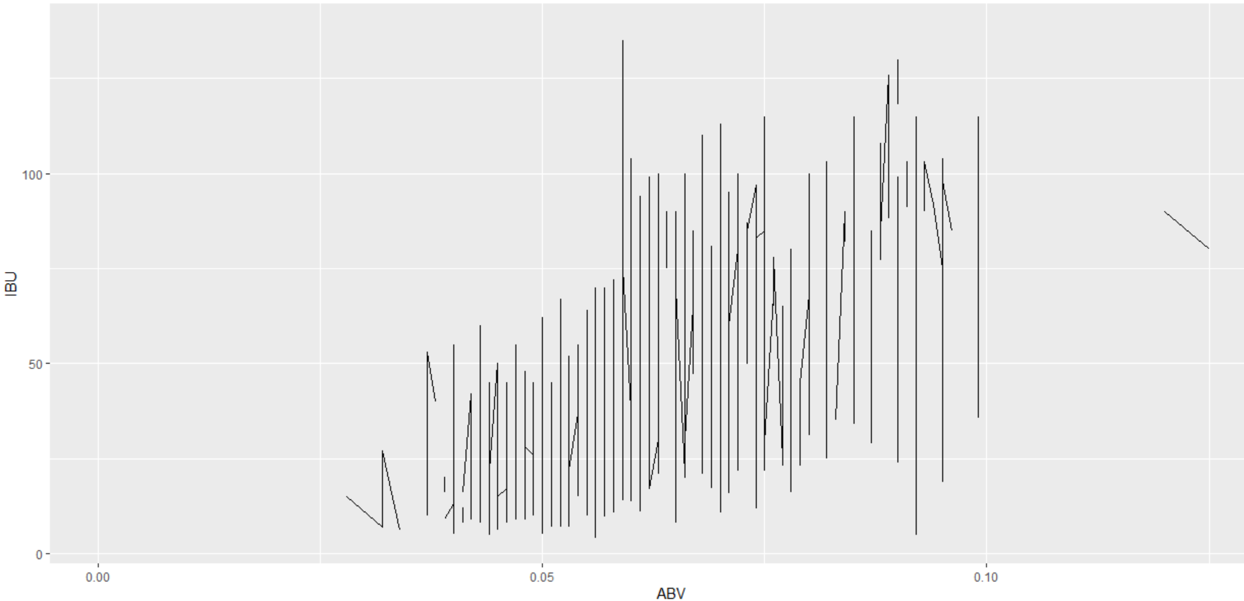
Is there an apparent relationship between the bitterness of the beer and its alcoholic content? Draw a scatter plot.

Slide 18
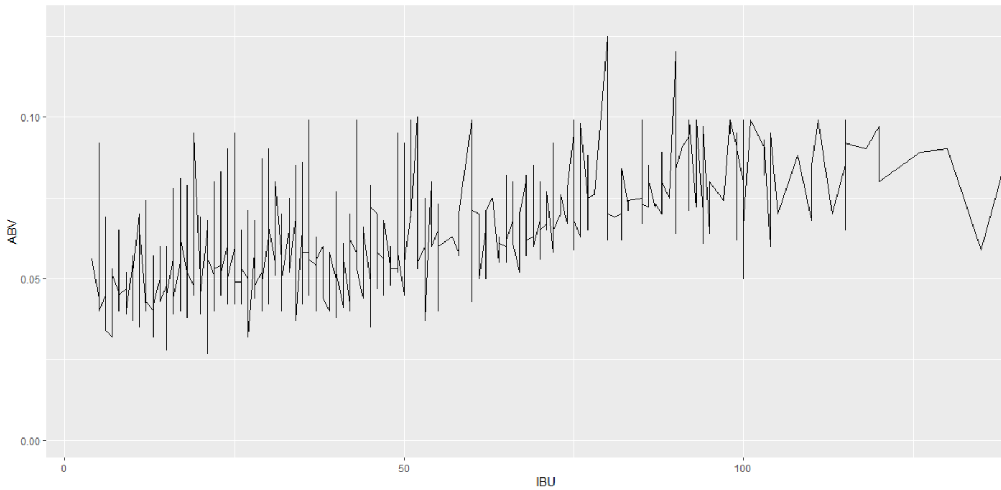
Is there an apparent relationship between the bitterness of the beer and its alcoholic content? Draw a scatter plot.

Slide 19
Relationship between the bitterness of the beer and its alcoholic content
IPA has a higher Alcohol and Bitter content than Ale

Slide 20
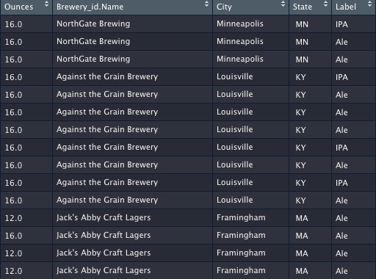
Relationship between the bitterness of the beer and its alcoholic content
KNN Analysis
We used regular expressions to create Label data

Slide 21
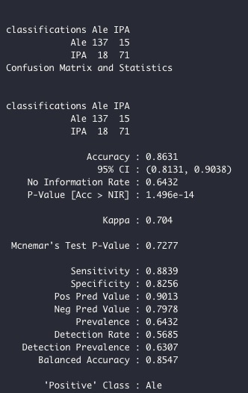
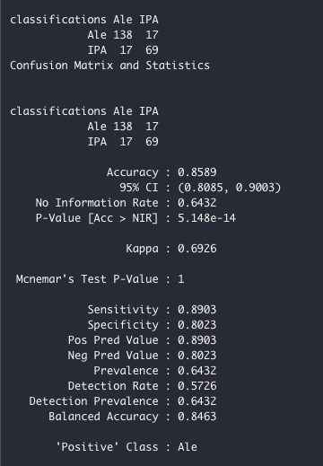
Relationship between the bitterness of the beer and its alcoholic content
KNN Analysis
We trained the data with .75 split
We then ran the model on K = 3 & 5
Below were our results
The model with K = 3 had 0.86 accuracy and K = 4 had accuracy of .85

Slide 22
Relationship between the bitterness of the beer and its alcoholic content
KNN Analysis
Were not satisfied with the results, so we plotted chart with the best K to use
And we discovered the best K is around the 0 to 20 region

Slide 23
Question-9 Find one other useful inference from the data that you feel Budweiser may be able to find value in. You must convince them why it is important and back up your conviction with appropriate statistical evidence. Optimum K Value Finding

Slide 24
When K=22 ,24,25
Optimum K Value Is K=23
K Value | Accuracy | Sensitivity | Specificity
24 | 0.8834 | 0.9057 | 0.8548
23 | 0.8869 | 0.9062 | 0.8618
22 | 0.8693 | 0.8981 | 0.8333

Slide 25
Precision/Recall for K=22,23,24, K=23 is Optimum
K Value | Precision | Recall
22 | 0.8703 | 0.8980
23 | 0.8888 | 0.9056
24 | 0.8888 | 0.9056

Slide 26
Optimum K Value Inference
When K=23 –is Optimum value Accuracy/Sensitivity/Specificity all higher.
It means 23 similar “Ale” Competitors Breweries form the nearest neighbours when K is optimum.

